Slide 1
SUBLEASE EXPIRY REPORT
Baltimore-Washington international Thurgood marshall airport
MDOT-AC-2023 General Information No. 1

Slide 2
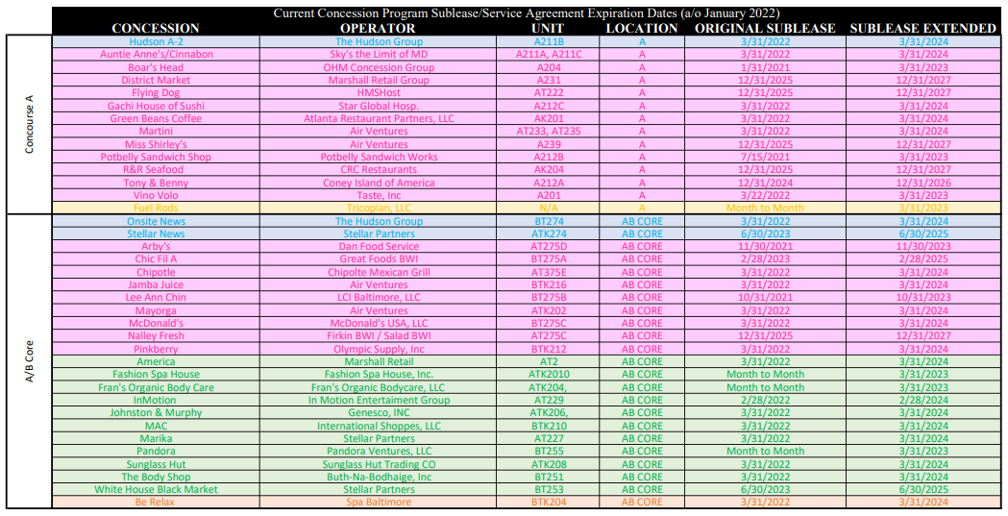

Slide 3
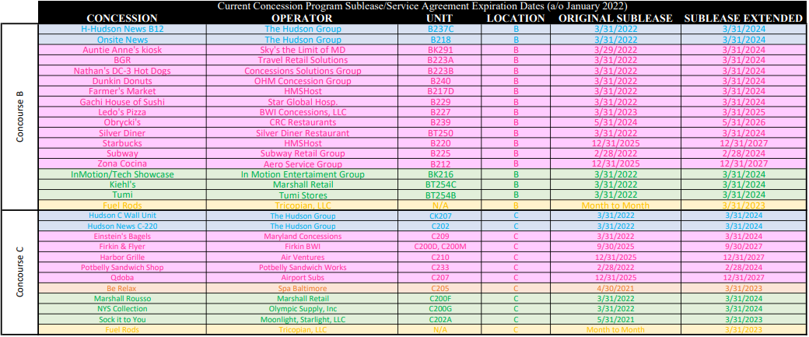

Slide 4
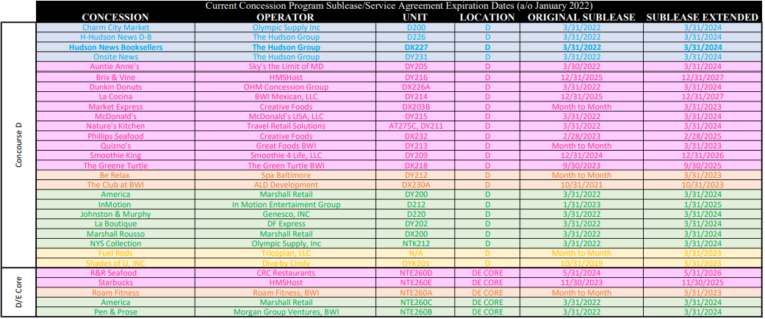

Slide 5
