Slide 1
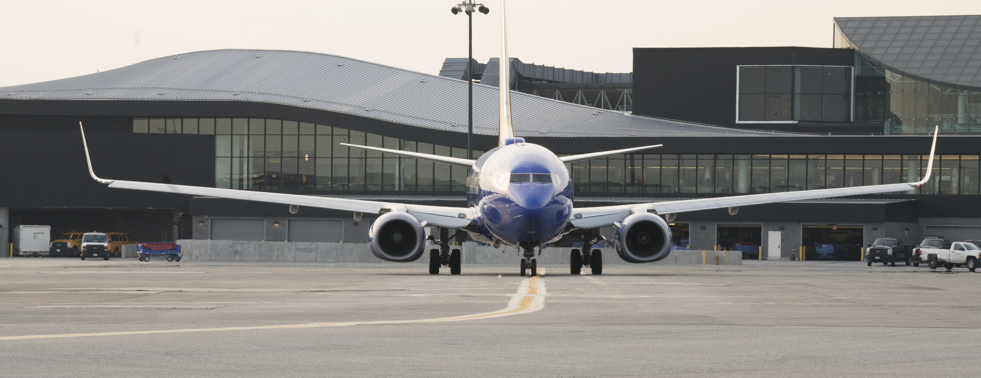
AIRLINE GATE UTILIZATION & ASSIGNMENT
Baltimore-Washington international Thurgood marshall airport
MDOT-AC-2023 General Information No. 17

Slide 2
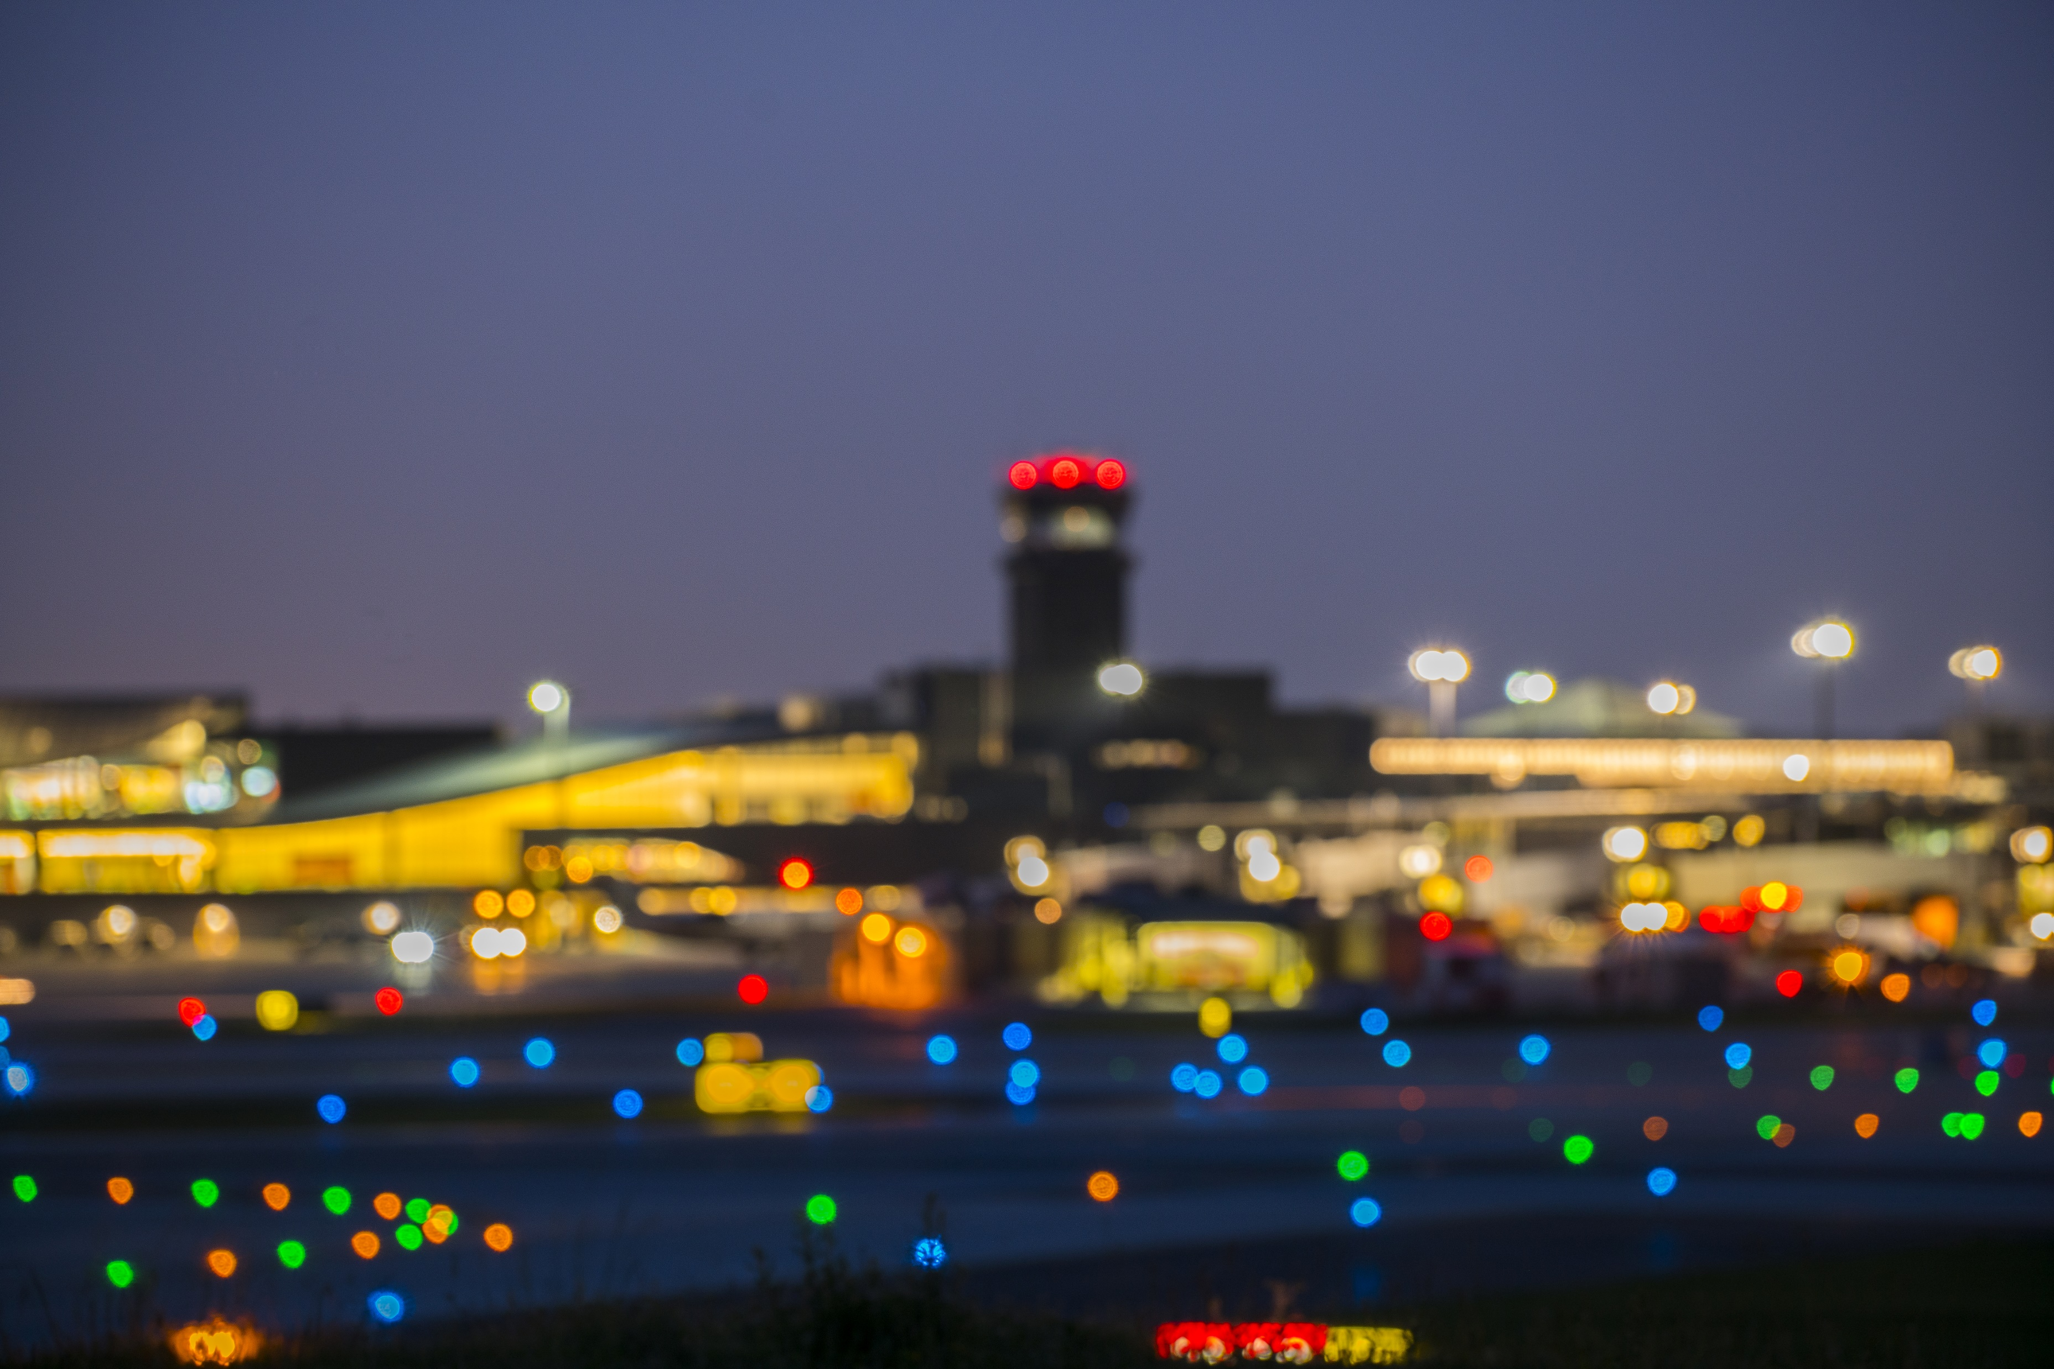
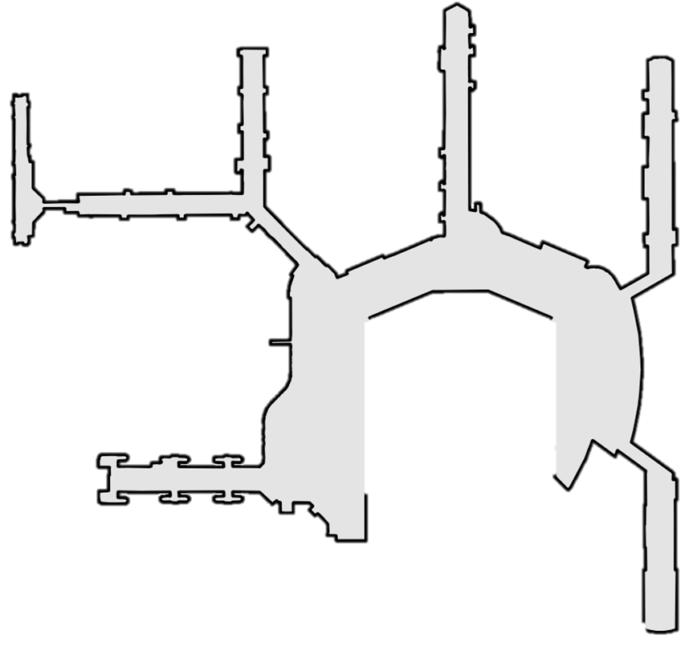
AIRLINE GATE ASSIGNMENTS AS OF MAY 2022
CONCOURSE C
CONCOURSE D
Gates C1, C3-5, C7 American Airlines
Gate C2 Common Use (Contour Air)
Gate C6 Common Use
Gates C8-C14 Southwest
Gate D2 JetBlue
Gate D4 Frontier
Gates D8, D10-12, D14 Spirit
Gates D13, D15, D16 United
Gate D20 Alaska Airlines
Gates D23-26, D29 Delta
Gates D1 Common Use (AMC)
Gate D3 Common Use
Gate D5 Common Use (Sun Country)
Gate D7 Common Use (Air Canada)
Gate D21 Common Use (Allegiant)
Gate D22 Common Use (Alaska, Avelo)
Commuter Gates
Gate 36 Common Use (Boutique)
Gate 37 Common Use
All other commuter gates closed.
C13
C14
C12
D15
D16
C11
B15
B14
D13
C10
D14
C9
C8
B13
B12
D11
D12
C7
C6
B11
B10
CONCOURSE B
D36
D7
D10
C5
C4
B9
B8
Gates B2-B15 Southwest
D37
D26
D24
D22
D20
D8
C3
C2
B6
D4
B7
C1
B5
B4
D29
D25
D23
D21
D2
B2
B3
D5
A1
D3
A2
D1
A3
E2
A4
CONCOURSE E
E10
E8
E6
E4
A5
CONCOURSE A
E12
All Gates are common use gates.
Gates E7 and E9-12 are arrivals only.
Gate E1 Common Use (British Airways)
Gates E3 and E6 (AMC (military flights))
Gate E4 Common Use (Icelandair)
Gate E5 Common Use (Air Senegal)
Gate E6 Common Use (Condor)
Gate E8 Common Use (PLAY)
A6
Gates A1-A16 Southwest
Gates A1-A5 are currently closed during expansion of the A/B Core.
A7
E9
E7
E5
E3
E1
A8
A9
A10
A11
A12
A13
A14
A15
A16
Gate assignments are current as of May 2022.

Slide 3
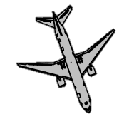
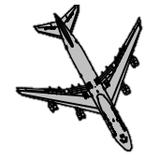
LARGEST AIRCRAFT: 2022
CONCOURSE C
B737-700W
Gates C1, C3 A320-200
Gate C2 B757-300W
Gate C4 B767-300
Gates C5, C7 B757-200W
Gates C6, C8-14 B737-800W
A320-200
CONCOURSE D
B737-800W
Gates D1, D3 B787-8 (D5 closed when 787-8 at D3)
Gates D2, D4, D8 B757-200W
Gate D7 B737-900W
Gates D10 B757-300
Gates D11, D12, D14 A321-200
Gates D13, D16 B767-300
Gate D15 B757-300
Gate D20 A321-200
Gate D21 A320-200
Gate D22 B737-900W
Gate D23 A320-200
Gates D24-26 B757-200W
Gate D29 B767-300
C14
C13
C12
B737-900W
D15
D16
C11
B15
B14
D13
C10
D14
C9
C8
B13
B12
CONCOURSE B
A321-200
D11
D12
B2-B15 B737-800W
C7
C6
B11
B10
B757-200W
D7
D10
C5
C4
B9
B8
D26
D24
D22
D20
D8
C3
C2
B6
B757-300W
D4
B7
C1
B5
B4
B757-300
D29
D25
D23
D21
D2
B2
B3
D5
A1
B767-300
D3
A2
B767-300ER
D1
A3
E2
A4
A330-200
CONCOURSE E
E10
E8
E6
E4
A5
CONCOURSE A
E12
Gate E1 B747-400
Gate E2 B737-900W
Gates E3, E5 B777-200
Gate E4 B767-300ER
Gate E5A B747-400
Gate E6 A330-200
Gates E7-E12 B737-900W
A6
Gates A1-5 B737-800W (currently closed for A/B Core Expansion)
Gates A6, A8 B737-700W
Gates A7, A9-16 B737-800W
B787-8
A7
E9
E7
E5
E3
E1
A8
A9
E5A
A10
A11
B777-200
A12
A13
A14
A15
B747-400
A16

