Slide 1
operational MANAGEMENT & performance
Baltimore-Washington international Thurgood marshall airport
General Information No. 2

Slide 2
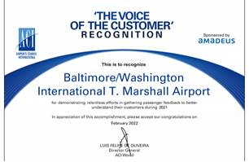
TABLE OF CONTENTS
INTRODUCTION
Disclaimer
OPERATIONAL MANAGEMENT PERFORMANCE
Joint Marketing Fund
Common Area Maintenance
Delivery & Distribution

Slide 3
DISCLAIMER
Past activity may not be indicative of future activity. The administration makes no guarantee of the accuracy or reliability of such information provided to the Administration by the airlines and other sources. All data provided is for informational purposes and the Administration is not responsible for any inaccuracies thereof. No warranty is intended or implied.

Slide 4
Operational management & performance

Slide 5
JOINT MARKETING FUND

Slide 6
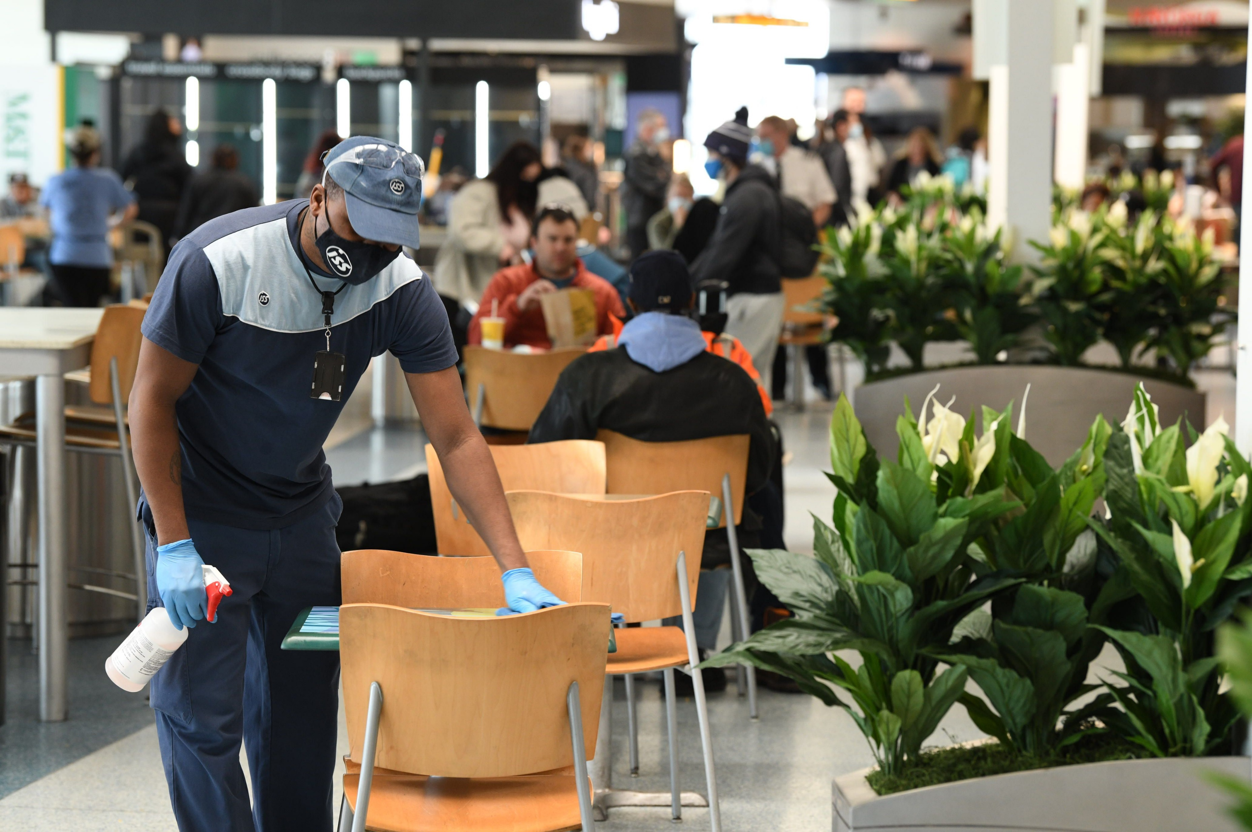
COMMON AREA MAINTENANCE (cam) FUND

Slide 7
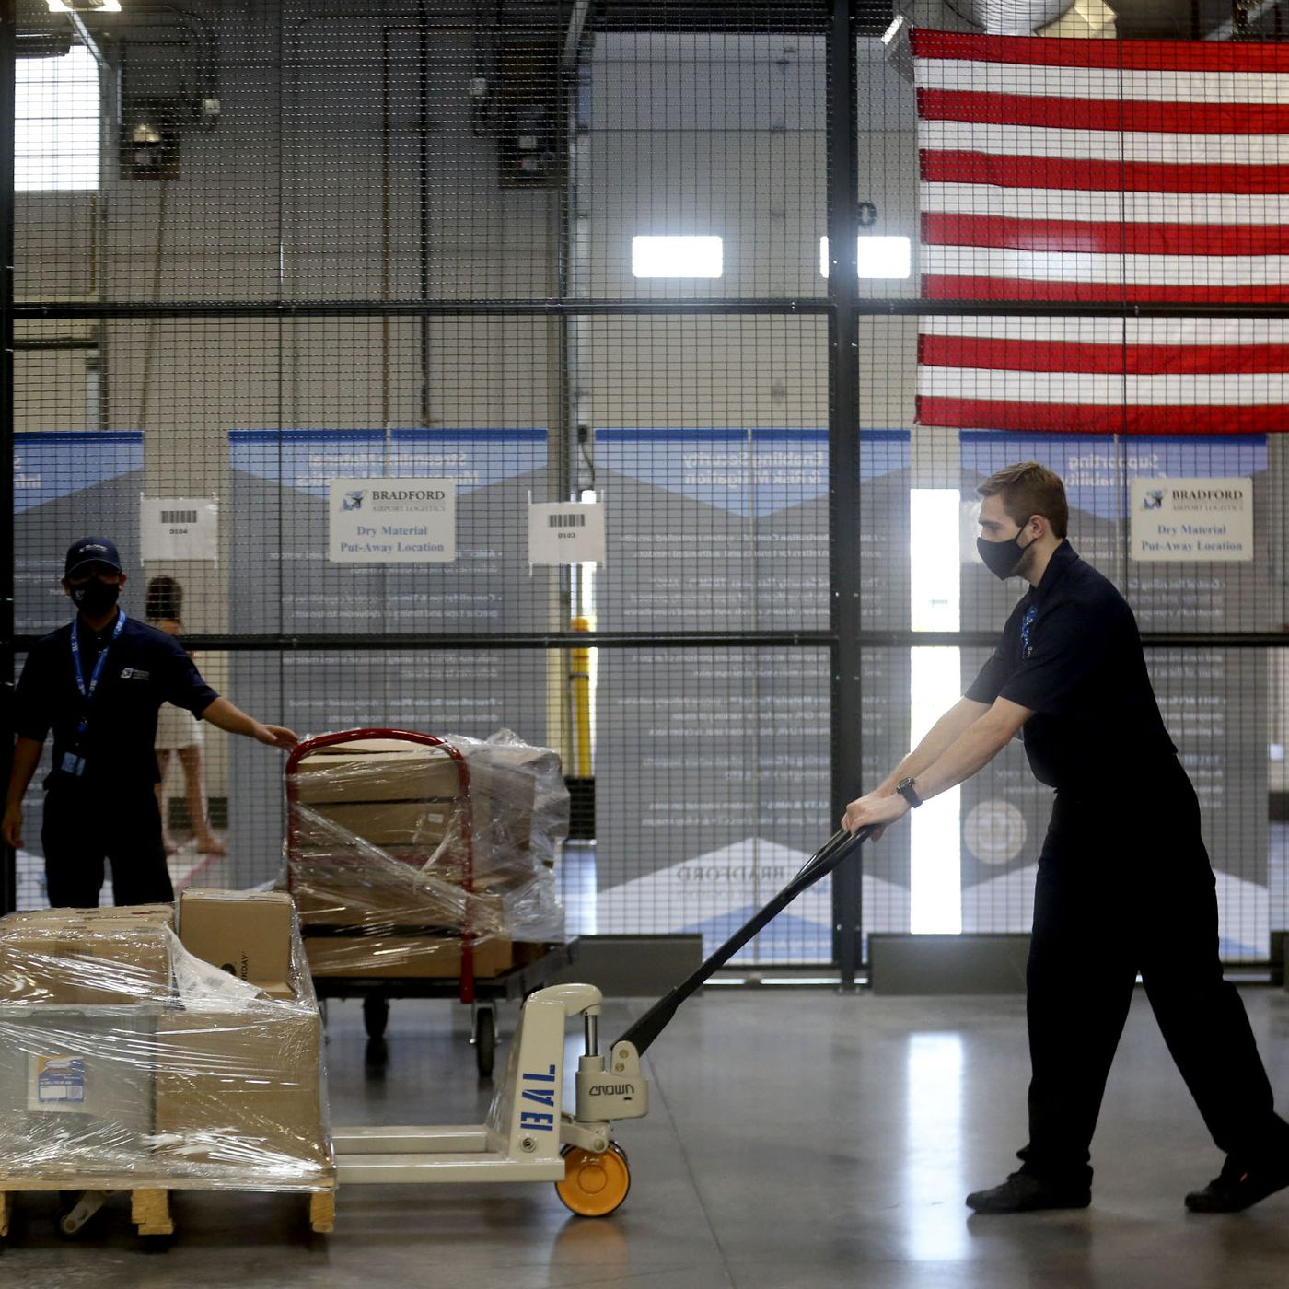
Delivery and Distribution FUND

Slide 8
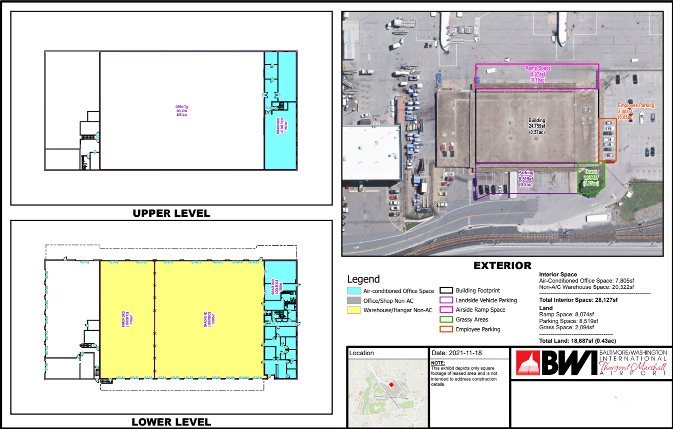
On-Airport centralized receiving and distribution facility (CRDF)
The CRDF is located in Building No. 107 on Air Cargo Road, immediately northwest and within walking distance of the Airport Terminal Building. The facility sits on a 1.58-acre parcel improved with a warehouse building. Bradford Logistics currently maintains approximately 13,560 square feet of non-air-conditioned warehouse space and 3,883 square feet of air-conditioned office space with another 3,922 square feet of air-conditioned office space at mezzanine level. The leased premises under a proposed new contract will expand the facility by 6,762 square feet, bringing the total amount of ground level warehouse space to 20,322 square feet. The facility is pending a nearly $1.1 million renovation.

Slide 9
