Slide 1
RFP #MDOT-AC-2023
for the Non-Exclusive Right to Redevelop, Renovate, Lease & Manage the Retail, Restaurant & Commercial Services
AT
BALTIMORE/WASHINGTON INTERNATIONAL
THURGOOD MARSHALL AIRPORT

Slide 2
PRESENTERS: JOY ABRAMS, CONTRACTING OFFICER DIRECTOR OF PROCUREMENT, THE SECRETARY’S OFFICE JAMES G. WALSH, A.A.E. CHIEF FINANCIAL OFFICER, MARYLAND AVIATION ADMINISTRATION JO A. SCHNEIDER AIA, LEED AP MARYLAND AVIATION ADMINISTRATION J. KEITH SCROGGINS DIRECTOR, DIVERSITY, EQUITY & INCLUSION, MARYLAND AVIATION ADMINISTRATION
WELCOME

Slide 3
AGENDA
General Information- Joy Abrams
Solicitation Schedule- Joy Abrams
Airport Overview- James G. Walsh
Airport Design & Development Overview- Jo A. Schneider
ACDBE Requirements- Keith Scroggins
Proposal Submission Requirements- Joy Abrams
Open Discussion
Closing Remarks- Joy Abrams
Mixer/Networking Session
Notes:
Q: Valerie

Slide 4
At the time of issuance of this RFP, a restriction on communication regarding all inquiries relating to this RFP will be imposed. Proposers and their representatives are substantially restricted from communicating with any party involved in the solicitation process including MDOT, its authorized officers, directors, agents, employees, volunteers, representatives, contractors, and consultants regarding this RFP. This restriction extends to phone calls, letters, emails, and any other form of contact that directly discusses this RFP and/or Proposals submitted in response to this RFP. All inquiries and submissions relating to and regarding this RFP shall be directed to the Contracting Officer. Violation of this restriction by a Proposer and/or its agent may lead to disqualifying the Proposer’s submittal from consideration.
GENERAL INFORMATION

Slide 5
GENERAL INFORMATION
The purpose of the Pre-Proposal Conference is to discuss the requirements and objectives of this RFP.
To receive an official response, all questions must be submitted in writing to the Contracting Officer by the Questions & Answers due date. Only responses provided by the Contracting Officer are binding.
MDOT will answer questions during the Pre-Proposal Conference but note that verbal answers are not official or binding to the State.
MDOT reserves the right to defer answering questions at the Pre-Proposal Conference and to address them after they have been submitted in writing.
Media questions must be submitted to The Maryland Department of Transportation Office of Public Affairs: Jim Joyner- 410-865-1030 or David Broughton- 410-865-1029

Slide 6
GENERAL INFORMATION
Mandatory Qualifications (Section III)
If the Proposer is a joint venture, partnership, or newly formed entity, the Proposer shall demonstrate that the majority stakeholder of the proposing entity satisfies the concession development and management experience qualification.
Must have at least seven consecutive years within the last ten years of demonstrated experience in designing, developing, leasing, financing, and managing the day-to-day operations of an airport concessions program, retail mall, and/or retail lifestyle center.
Please note that MDOT shall not accept the experience of individual employees, combinations of employees, or a Guarantor to meet the Mandatory Qualification for experience.
Must agree to cause each of its sublessees and subcontractors to enter into a labor peace agreement.
Notes:
Q:

Slide 7
GENERAL INFORMATION
Mandatory Qualifications (Section III)
Must be financially capable of successfully financing, designing, constructing, implementing, and managing the proposed concessions management service based on submitted information/documentation demonstrating the Proposer’s ability to finance and undertake monetary commitments for a minimum of $30 million
Must submit all other information required to be submitted by this RPF.
Failure of a Proposer to meet the Mandatory Qualifications shall result in MDOT finding the Proposer’s submittal to be non-responsive and thus not susceptible to award and will result in the rejection of the Proposal.
Notes:
Q:

Slide 8
GENERAL INFORMATION
Exceptions
By submitting a Proposal in response to this RFP, a Proposer, if selected for award, shall be deemed to have accepted the terms and conditions of this RFP and the Contract, attached as Exhibit A. Exceptions to the requirements must be included in the Proposal submission. Any other exceptions shall be so noted in and clearly identified in the Exceptions Matrix (Form 4) of the Proposal. All exceptions will be taken into consideration when evaluating the Proposer’s submission. MDOT reserves the right to accept or reject any exceptions. At the sole discretion of the MDOT, exceptions to any part of the RFP may deem the Proposers proposal to be non-responsive and not susceptible for award.

Slide 9
GENERAL INFORMATION
INTERVIEWS & PRESENTATIONS
The Selection Evaluation Committee reviews and ranks Proposals received from Proposers that have been “preliminarily deemed reasonably susceptible for award” according to the criteria in this RFP.
At the sole discretion of MDOT Proposers may be invited for interviews with the Selection Evaluation Committee.

Slide 10
GENERAL INFORMATION
SOLICITATION SCHEDULE
MDOT has established the following tentative schedule for the submission of Proposals, evaluation, selection, and contract award under this RFP:
September 18, 2023, Issuance of RFP
October 11, 2023, Pre-Proposal Conference
October 11, 2023, After Pre-Proposal Conference Mixer/Networking Session
(1:00pm – 4:00pm Local Time)
Notes:
Q:

Slide 11
GENERAL INFORMATION
SOLICITATION SCHEDULE (Continued)
4. October 12, 2023, Site Development Tour
(10:00am – 12:00pm Local Time
October 19, 2023, Deadline to Submit Questions (by 12:00pm Local Time)
December 4, 2023, Submission of Proposals (by 2:00pm Local Time)
7. Spring 2024. Notice of Recommended Award to Selected Proposer & Notices to all other Proposers

Slide 12
Airport overview
James Walsh, A.A.E. Chief Financial Officer
Maryland Aviation Administration

Slide 13
Airport Overview
BWI Marshall Recovery
“V” Shaped
28 million annual pax/75,000 everyday
Southwest added 7 markets
New International Service – COPA
Passenger Forecast (2030)
Robust – 35 million annual passengers/96,000 everyday
$1.2 Billion Capital Program
$425 million A/B Connector & BHS Project
Restrooms
Southwest Aircraft Maintenance Base
30-year lease
Long Term Commitment

Slide 14
Airport Overview
MDOT’s RFP GOALS & OBJECTIVES
To contract with a development firm that has a demonstrated capability and the commanding character to captivate, stimulate, and maximize passengers' engagement and experience through its end-to-end concessions development philosophy;
To facilitate, produce, and advance industry-leading opportunities for minority, disadvantaged, and emerging small businesses to successfully participate in the full array of concessions opportunities at the Airport;
To optimize and maximize revenues to the Airport; and
To stimulate economic development for the benefit of the local community, the region, and the State of Maryland.

Slide 15
Airport Overview
THE ADMINISTRATION’S RFP GOALS & OBJECTIVES
Expand Regional Participation
Foster an Elevated Measure of Performance
Enhance the Passenger Journey and Experience
Optimize the Passenger Digital Experience
Affordable Prices & Fresh, High-Quality Foods
Commitment to Diversity & Economic Development

Slide 16
Design and Development overview
Jo A. Schneider, AIA LEED AP
Maryland Aviation Administration

Slide 17
Design and Development overview
Jo A. Schneider A|A LEED AP

Slide 18
Design and Development overview

Slide 19
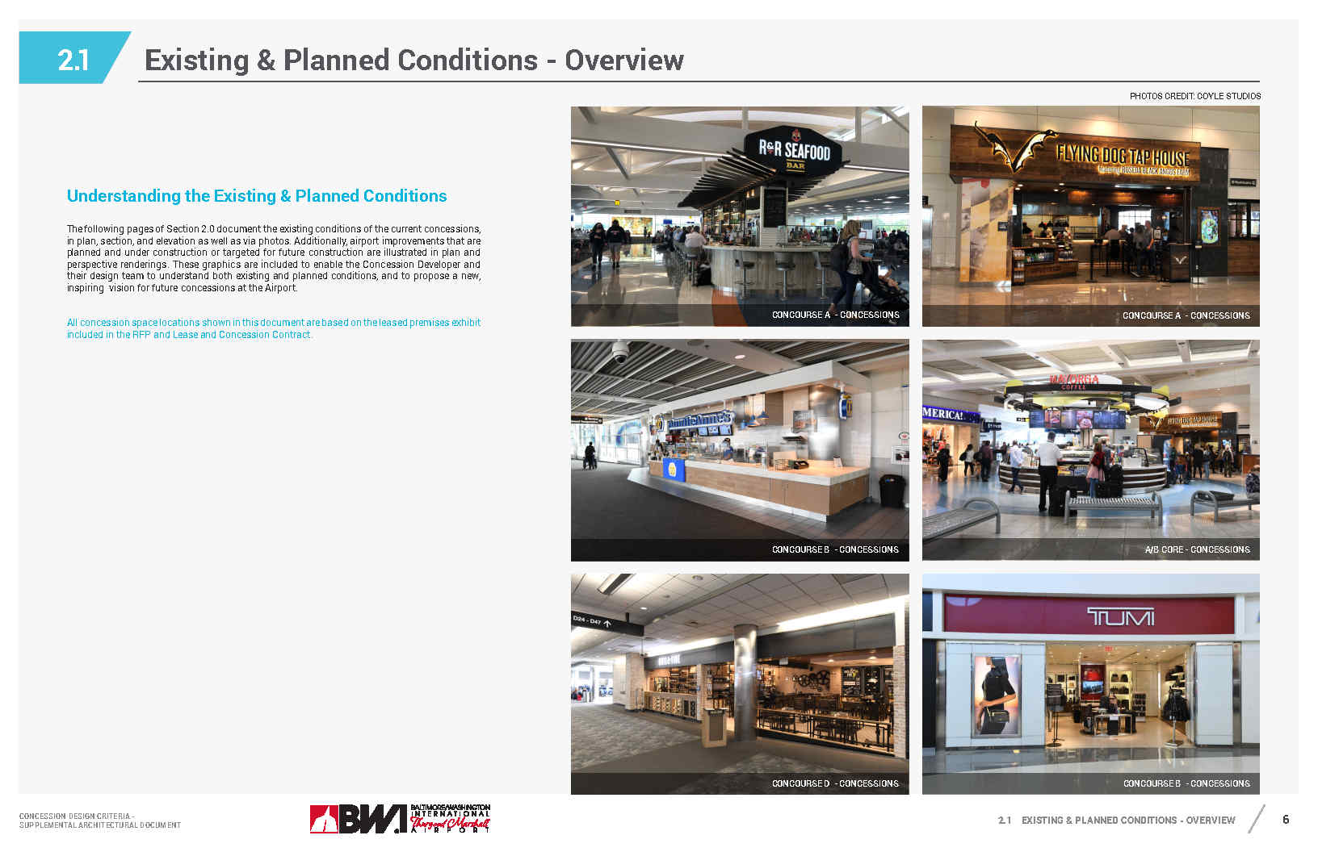
Design and Development overview
Jo A. Schneider A|A LEED AP

Slide 20
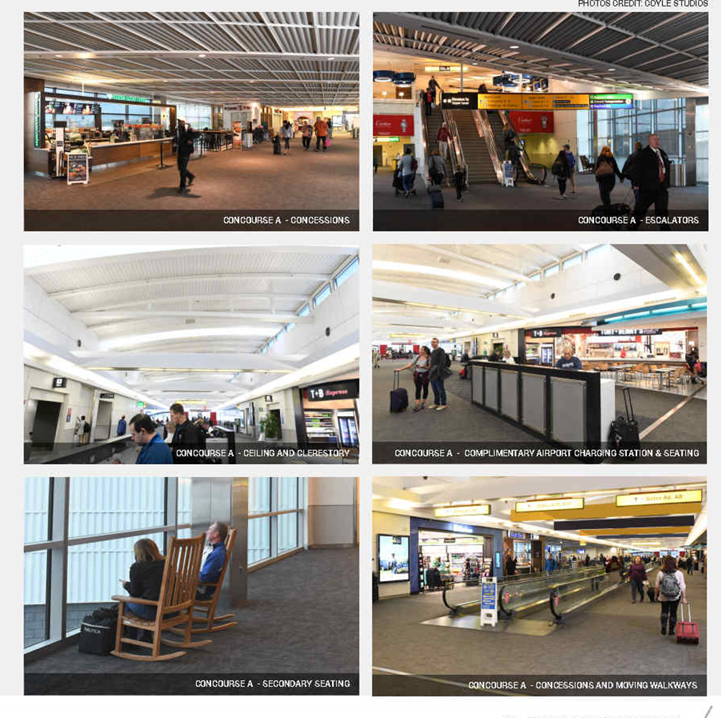
Design and Development overview CONCESSION ARCHITECTURE: EXISTING CONDITIONS - CONCOURSE A

Slide 21
Design and Development overview CONCESSION ARCHITECTURE: EXISTING CONDITIONS – A/B Food court

Slide 22
Design and Development overview CONCESSION ARCHITECTURE: EXISTING CONDITIONS – C CONCOURSE/CENTER TERMINAL

Slide 23
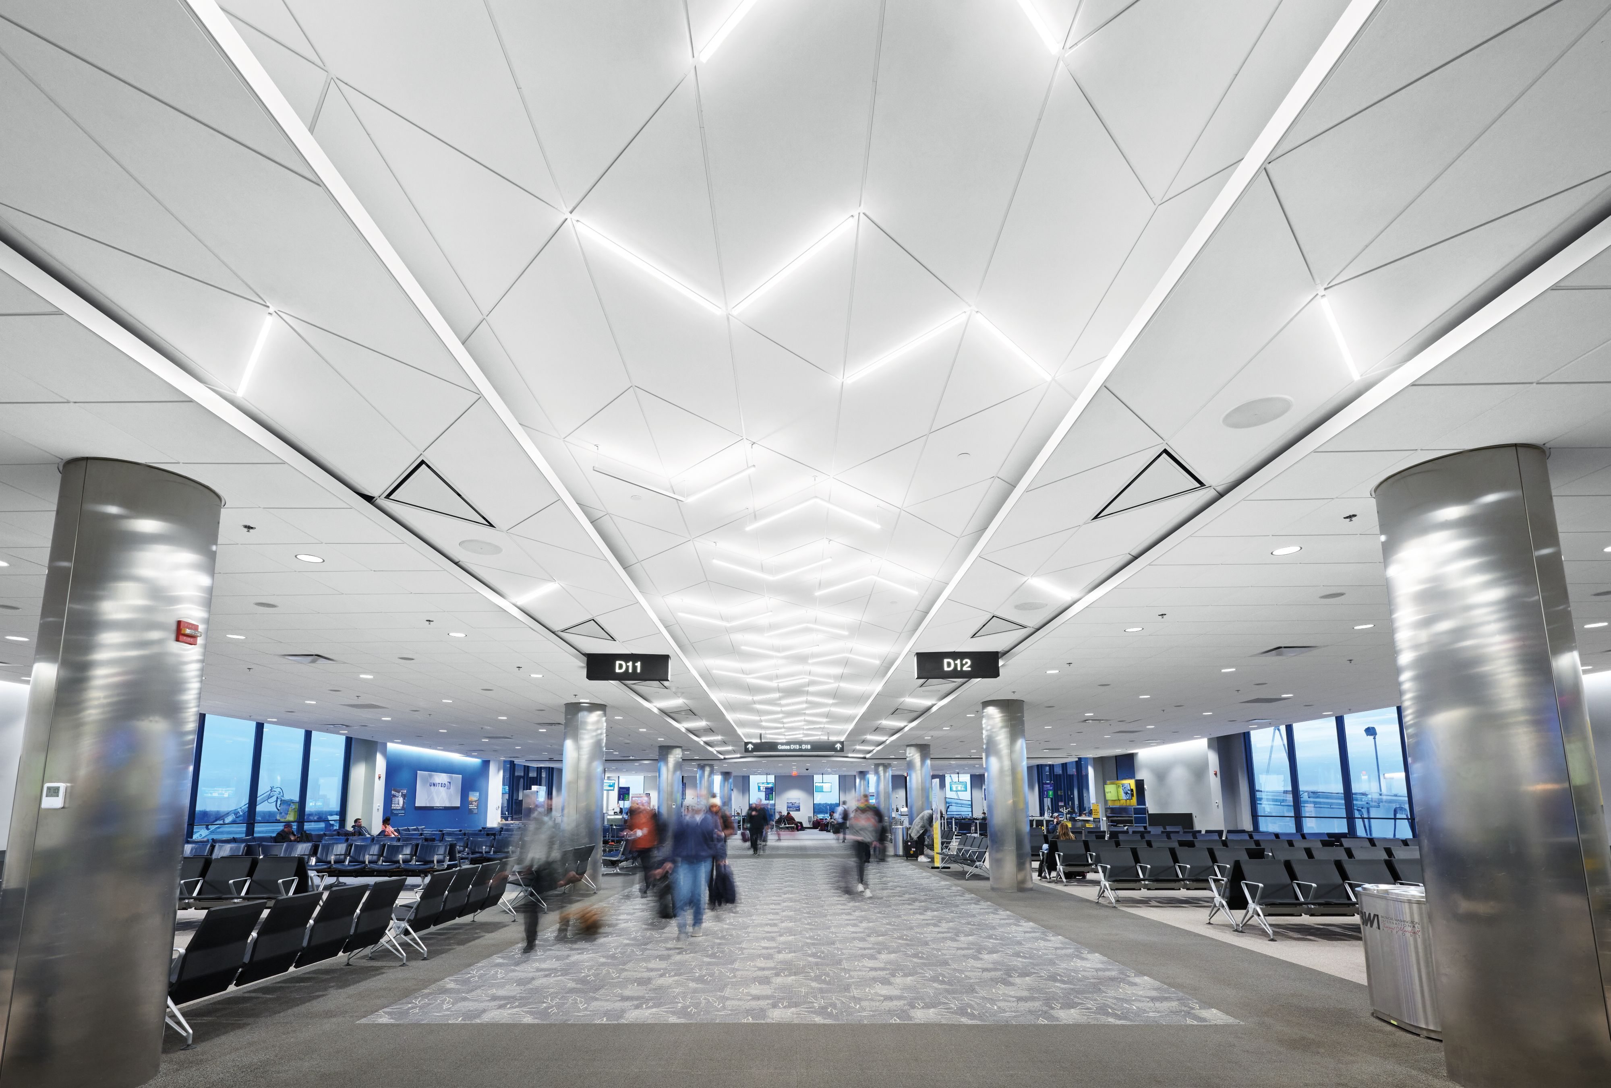
Design and Development overview Concession ARCHITECTURE: EXISTING CONDITIONS – DX/DY

Slide 24
Design and Development overview CONCESSION ARCHITECTURE: EXISTING CONDITIONS – E CONCOURSE/DE CORE

Slide 25
Design and Development overview
A/B CORE EXPANSION PROGRAM

Slide 26
Design and Development overview Future A/B Core Expansion and Baggage Handling
AB Connector and Baggage Handling System Facts
Overall Building: total 700’ wide x 118’ long
Three open bays: 44’ per bay/ 140’ wide x 118’
Heights: 15’ to 24’ (restricted by sight lines from tower)
Square footage:
Overall Level 1 – 123,000 sq ft
Overall Level 2- 98,000 sq ft
_________________________
Total Square Footage – 221,000 sq ft.
Retail Flex space total ……28,789 sq ft
Marketplace total………... 14,078 sq ft
Total ……………………………..42,867 sq ft
Completion Date July 2026

Slide 27
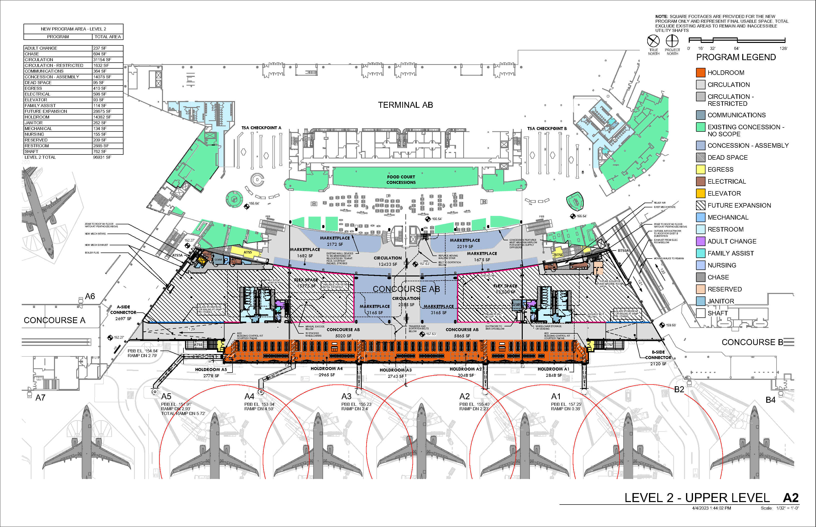
Design and Development overview

Slide 28
Design and Development overview Future A/B Core Expansion and Baggage Handling - Aerial Rendering

Slide 29
Design and Development overview Future A/B Core Expansion & Baggage Handling - Interior Rendering
Concession Images Do Not Represent Expected Design Specifications

Slide 30
Design and Development overview Future A/B Core Expansion & Baggage Handling - Interior Rendering
Concession Images Do Not Represent Expected Design Specifications

Slide 31
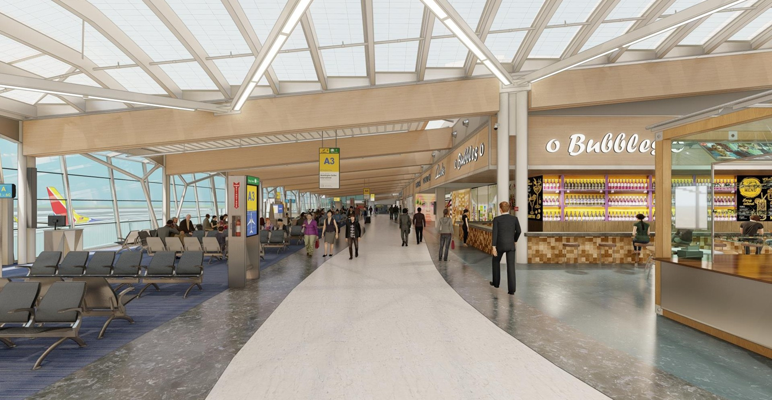
Design and Development overview Future Conditions – A/B Connector Interior Rendering
Concession Images Do Not Represent Expected Design Specifications

Slide 32
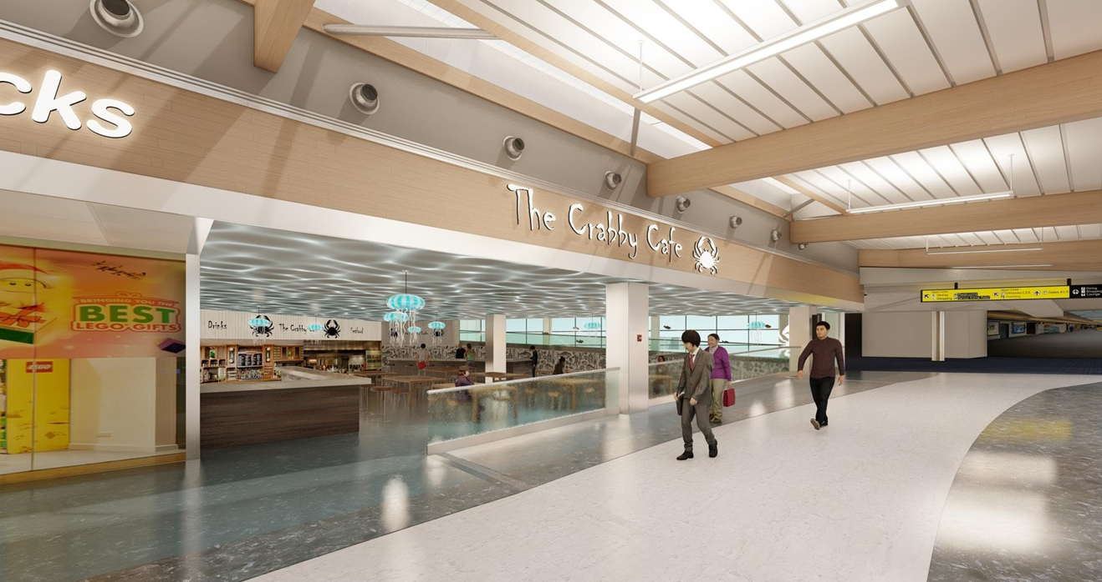
Design and Development overview Future Conditions – A/B Connector Interior Rendering
Concession Images Do Not Represent Expected Design Specifications

Slide 33
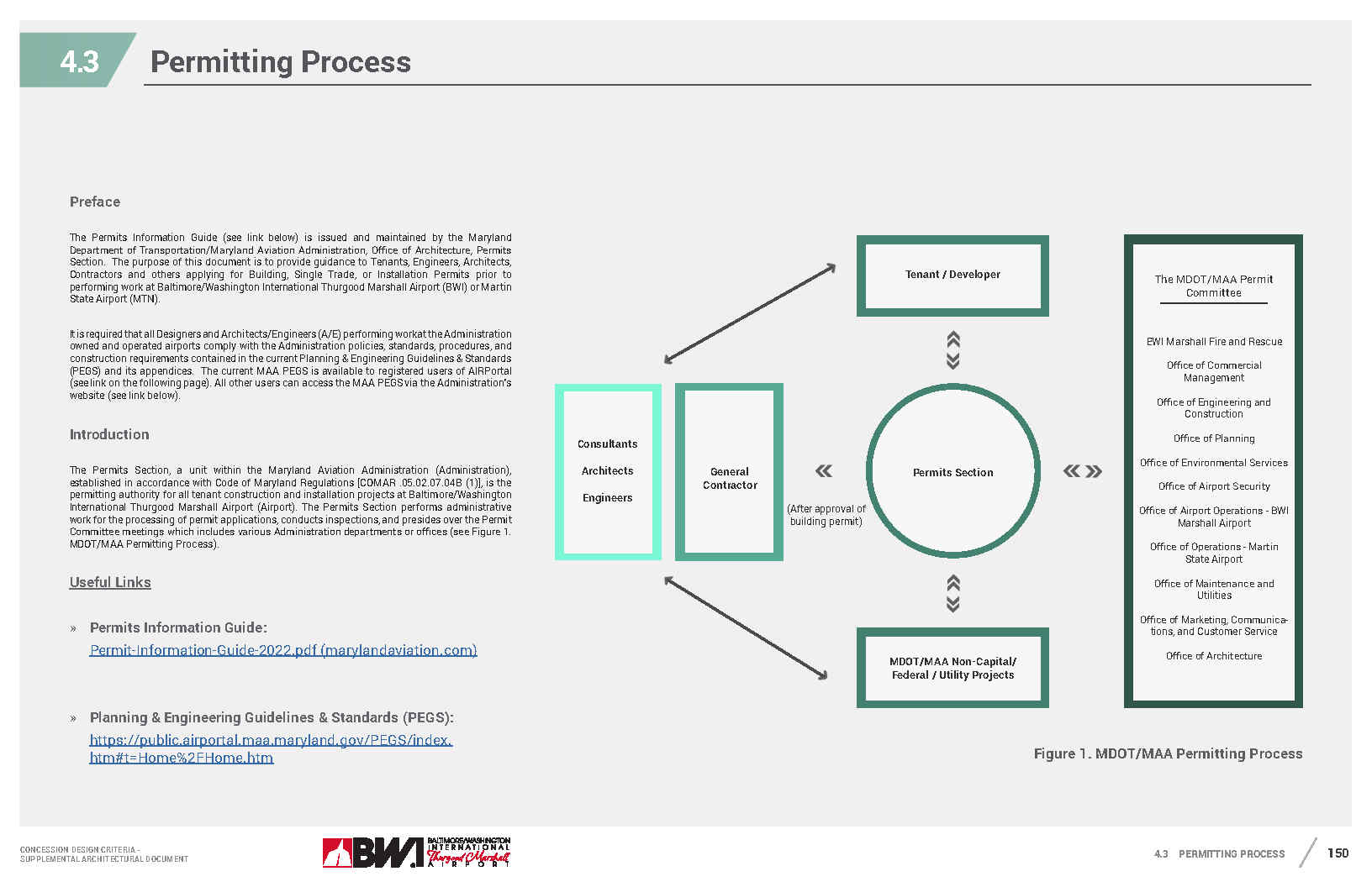
Design and Development overview CONCESSION ARCHITECTURE: DESIGN STANDARDS & PROCESS/PERMITTING

Slide 34
ACDBE Requirements
J. Keith Scroggins
Director, Diversity, Equity and Inclusion Maryland Aviation Administration

Slide 35
Acdbe requirements
ACDBE PROGRAM Overview
ACDBE Definition-A concession that is a for-profit small business concern that:
Is at least 51% owned by a socially and economically disadvantaged individual (s)
The management & daily operations of the firm are controlled by the socially and economically disadvantaged individual (s) who own it
Concessions include businesses operating retail, food & beverage and service locations within the airport; may also include other firms providing goods and services to concessionaires via subcontract arrangements.
Participation may be achieved via direct leases, joint ventures, management contracts and subcontracts.
Notes:
Q:

Slide 36
Acdbe requirements
ACDBE PROGRAM Overview
ACDBE Firm Requirements
Size Standards
$56.42 million in gross receipts for most ACDBE firms
$75.23 million in gross receipts for car rental firms
Averaged over previous fiscal years
Personal Net Worth (PNW)
ACDBE PNW cap, $1.32 million except
Equity in owner’s primary residence
Assets invested in the business
Notes:
Q:

Slide 37
Acdbe requirements
ACDBE PROGRAM Overview
ACDBEs and joint venture entities consisting of ACDBEs and non-ACDBEs are strongly encouraged to participate in this RFP
ACDBE participation at BWI surpassed 40% in 2020 and 2021 and 2022
Participation has surpassed 35% every year since 2018
See General Information Item No. 3 (Opportunity Performance and Analysis) for additional details on ACDBE participation
Notes:
Q:

Slide 38
Acdbe requirements
ACDBE contract participation goal
The Administration has established, in accordance with federal regulations, an ACDBE participation goal for this contract of 30.32%.
This established and approved goal combines food and beverage, retail, and commercial services participation.
As per FAA regulations, the ACDBE participation goal is subject to change every three years.
If for any reason Proposer is unable to structure the contract requirements in its Proposal with 30.32% ACDBE participation, Proposer may request a waiver to the goal
Proposer is required to justify a waiver request with sufficient written documentation of its good faith efforts to achieve the ACDBE participation goal
Notes:
Q:

Slide 39
Acdbe requirements
ACDBE submission information
Proposers must submit the following information:
A current copy of the MDOT ACDBE certification for each ACDBE firm that will participate in the Contract to be Awarded. The registered NAICS codes to identify items being purchased or services to be provided by each participating ACDBE firm;
A description of the legal arrangement(s) to be utilized (sublease, joint venture, partnership, etc.); and
A draft copy of the legal document to be executed between the Proposer and each named ACDBE Firm(s)
Notes:
Q:

Slide 40
Acdbe requirements
ACDBE submission information
ACDBE firms must be certified by MDOT at the time of proposal submission. Expired certifications or certifications from other federal, State, county or local agencies are unacceptable;
Notes:
Q:

Slide 41
Acdbe requirements
ACDBE PLAN
Proposers are required to submit:
Description of the overall ACDBE Plan, including the number of ACDBE participants and the nature of their participation
How the Proposer intends to meet and maintain the ACDBE participation goal
Business experience of each ACDBE firm that will participate in the Contract
Total financial value of ACDBE management or service subcontract(s) or subleases for the first five years of Term; and/or projected gross receipts for ACDBEs (e.g. franchisees, joint venture partners, etc.)
Approach to help improve ACDBE performance, and in the event that approach fails, the approaches it will employ to replace that ACDBE Firm with another ACDBE Firm
Notes:
Q:

Slide 42
Diversity, equity, and inclusion
Diversity, Equity, and Inclusion submission information
Good-faith efforts to reach out to small businesses, including certified MBEs and certified VSBEs, for contracting and subcontracting opportunities to maximize participation
Notes:
Q:

Slide 43
Open discussion
REMINDER: ALL QUESTIONS MUST BE SUBMITTED IN WRITING TO THE CONTRACTING OFFICER (JOY ABRAMS) FOR AN OFFICIAL RESPONSE IN WRITING
Notes:
Q:

Slide 44
CONCLUSION
Enjoy the mixer/ networking session
Notes:
Q:

